Slide 1
Title:BTS site configuration independence of cabling
Inventor: Xu Yang Chun
Date:2013.6.5
Short description The BTS configuration shall independence of cabling, so configuration type can change without site visit to re-cable.
Innovation type: Site solution
Expected output: Feasibility study report

Slide 2
Agenda
Overview the innovation
Key innovation points
Solution description – innovation points
Benefits and value
Further extend

Slide 3
Biz Background and Drivers
Business Drivers for the proposal
Background
Now BTS configuration type based on how RF- System module connected and the commission file
Challenge So if customer/service team want to change the configuration type ,they must do site visit and re-cable the RF<->SM connection. Even in the case(shown in followed slides) , we change from one configuration needed 4 pair SFP to another configuration to 2 pair needed, the re-cabling is must too. it is not only cost money but also not easy to get permission from the operator/BTS room owner, so re-cabling always pend the deployment/trial project.
Target
BTS Configuration type specified in commission (file), no re-cabling needed.
Notes:
<number>

Slide 4
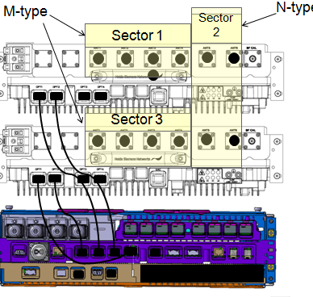
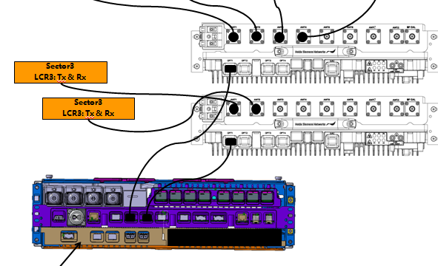
Example: change from the left type to right need re-cabling too, not by RP3 capacity limit

Slide 5
Innovation points
Now BTS O&M SW judge the BTS configuration type based on RF<->SM connection and commission file.
If separate the connection identification with BTS config type judge.
The BTS config type is specified in commission file, no judge needed.
The SW will be more robust become simplicity.
And it will also benefit to NSN service team/operator’s network deployment/ maintenance work.

Slide 6
Benefit and value
Benefit of innovation:
BTS configuration type specified in commission file
The BTS configuration are easy to change.
Save deployment cost and time for both NSN and Customer
Notes:
introduce the benefit and the value of the innovation to customer or product.
Introduce the advantage and disadvantage of this innovation

Slide 7
Further extend
The RF⬄SM connection shall be more simple
Limit to 1 fiber connection as possible
Notes:
introduce the benefit and the value of the innovation to customer or product.
Introduce the advantage and disadvantage of this innovation

Slide 8
History
Version | Date | Author | Decision | Notes/Review body

